Slide 1
In the news
How much are you paying attention?

Slide 2
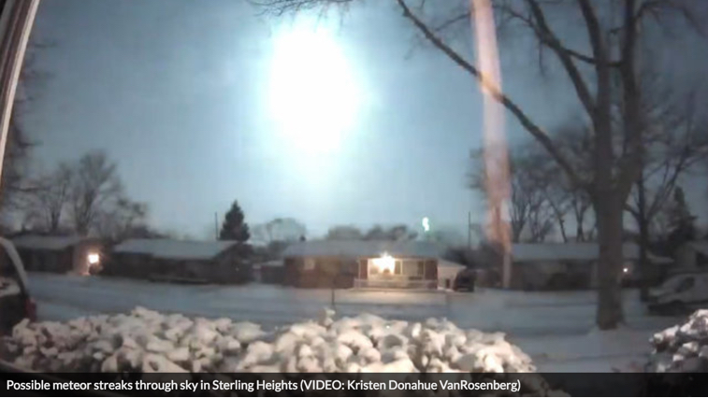
What was the flash and boom last night?
A very slow moving meteor – speed of about 28,000 m.p.h.
Registered as a 2.0 earthquake
Where did you first hear about it?
Fun fact: If you find a piece of meteorite, and you're willing to part with it, you could be able to sell it for $300 per gram or more – meaning 1 pound could be worth $1 million.

Slide 3

Pop news quiz (not for credit)
Who is this man?
What happened in the past week involving him?
Who is Robert Mueller? How is he involved?
What is Breitbart?
LINK to story
Stephen Bannon, former chief strategist to Donald, was subpoenaed to appear in front of a grand jury by Robert S. Mueller III, the special counsel investigating possible Russian connections to Trump associates.

Slide 4

What event is happening in Detroit this week?
Also, one of the largest media events in North America
In its 30th year as an international event
One of the biggest news events for local media
North American International Auto Show

Slide 5
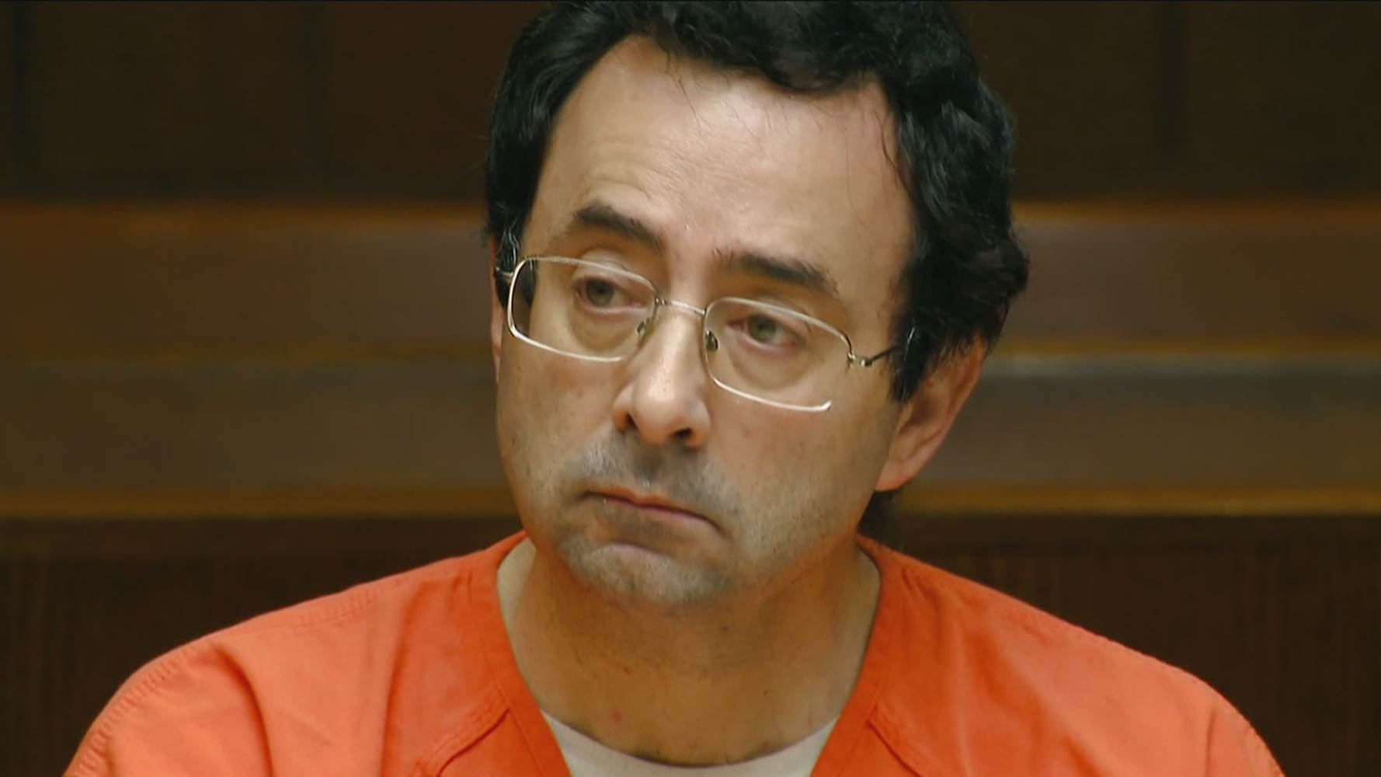
Who is Larry Nassar and why is he in the news?
Former doctor to the gymnastics stars
Sentencing began Tuesday in his trial
29 women spoke in impact statements today about being abused; 98 expected all together

Slide 6

“Shithole countries”: Who, what, where and why?
Who: Donald Trump allegedly used the phrase
What: The countries were Haiti and some African countries
Where: In an Oval Office meeting attended by a number of lawmakers
Why: It’s significant because of the impact it has had worldwide, and here as well – thrusting attention on this issue.
Washington Post: “Trump derides protections for immigrants from ’shithole’ countries”

Slide 7
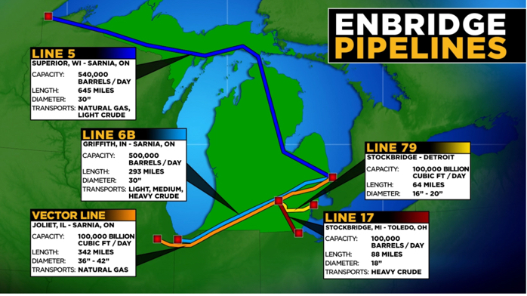
What is ‘Line 5’ and why is it in the news?
Line 5 is an oil pipeline, built in ‘50s, running under the Straits of Mackinac
Advocates have pushed for years for a shutdown of the line, claiming its age makes it vulnerable
A break in the line could threaten Great Lakes
Advocates this week put forth their shutdown proposal
WoodTV in Grand Rapids: Some of the best coverage. WHY?

Slide 8

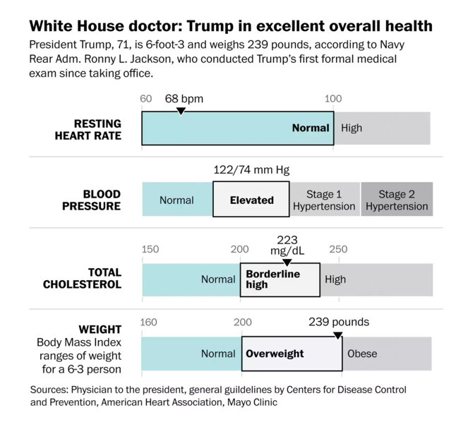
How healthy is this guy?

