Slide 1
How to create data-driven stories

Slide 2
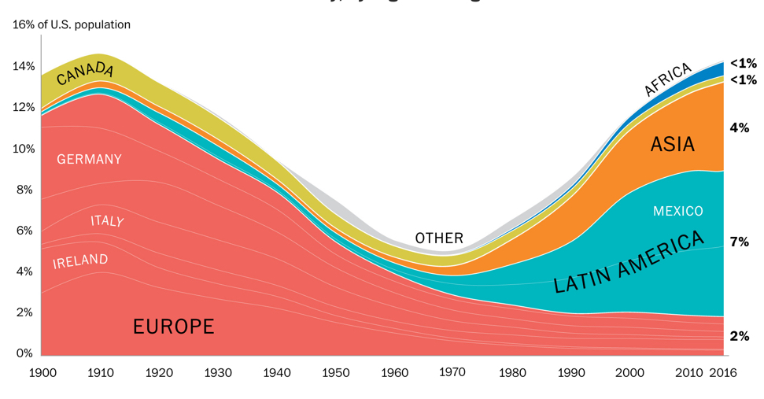
What is data-driven journalism?
Wikipedia: “Analyzing and filtering large data sets for the purpose of creating a news story.”
Find it
Filter the data set
Analyze, visualize
Tell the story

Slide 3
Find it
Where do you find the data?
  Call the agency you are interested in and ask if they have data online.
  Online forms, charts, stats: follow the paper trail to its source
  Ask academics, watchdog groups, others in the know where to find info you are looking for
  Use Google’s advance search function (google.com/advanced_search)
  File a Freedom of Information request (More on FOIA here)

Slide 4
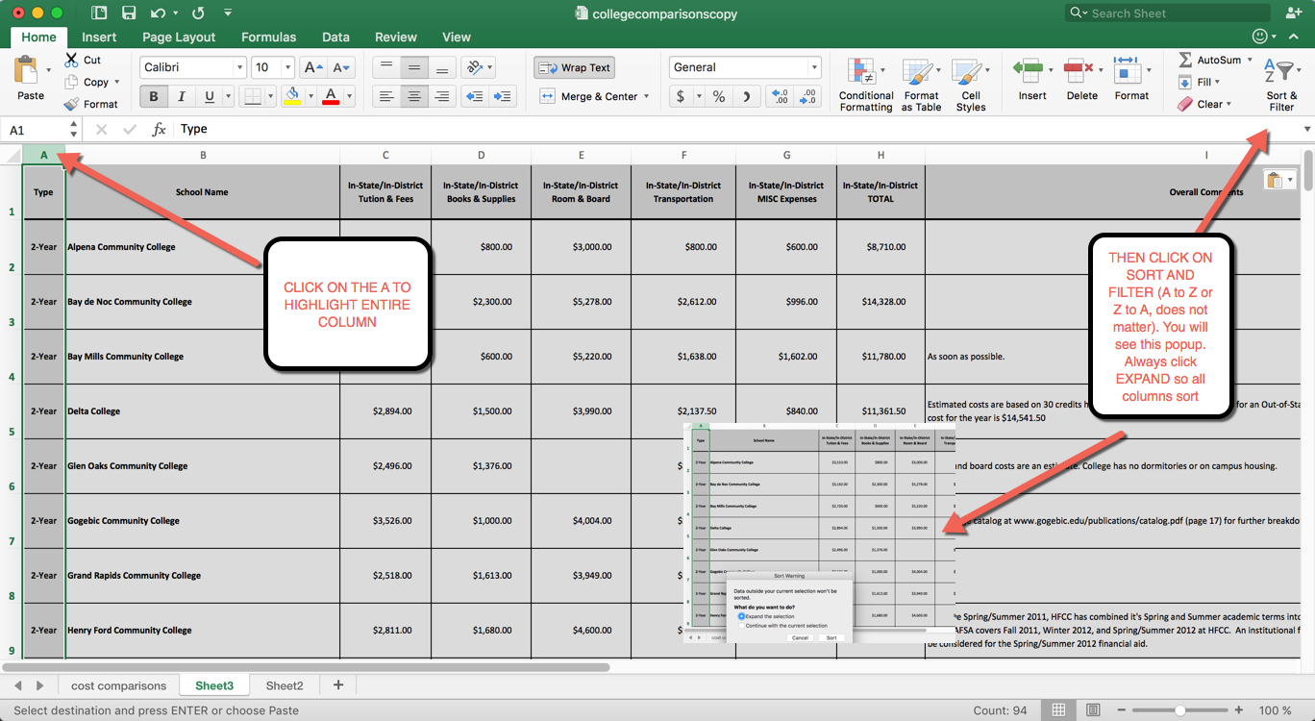
Filter it
Hone it down to what you want or need
Eliminate unneeded columns or rows
Filter by year, month, or some other factor

Slide 5
Analyze it
Understand the data – every field, every fact. Know where it came from and check the math for errors.
Get what you need to interpret it
Ask your data questions – averages, max, min, top 10
Look at ways to measure it (rate of change, change over time, etc.)
Put it in groups (geographical, historical, demographic)
Be careful of errors
Use tools to clean and standardize (Open Refine)

Slide 7
Start with …
Trends – ups, downs, static
Rank order – how things are ordered
Comparisons – Trump’s presidency, today vs. a year ago
Surprises – You’d think crime was going up, but it’s actually dropping
Relationships- causal relationships like aging pipes + lack of monitoring = Flint water crisis

Slide 8
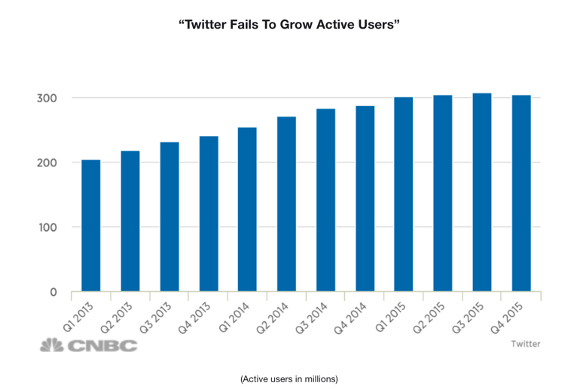
Trends
Rise or fall over time
Growth in use
Flattening of a trend
ONCE YOU SPOT A TREND, THE NEXT QUESTION IS … WHY?

Slide 9
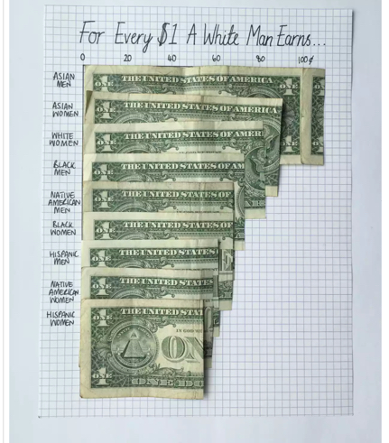
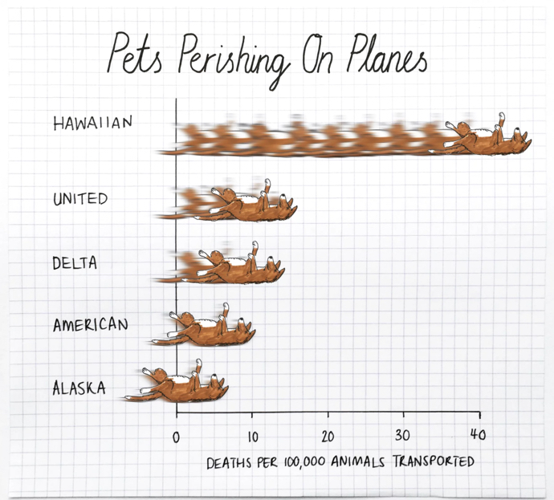
Rank order

Slide 10
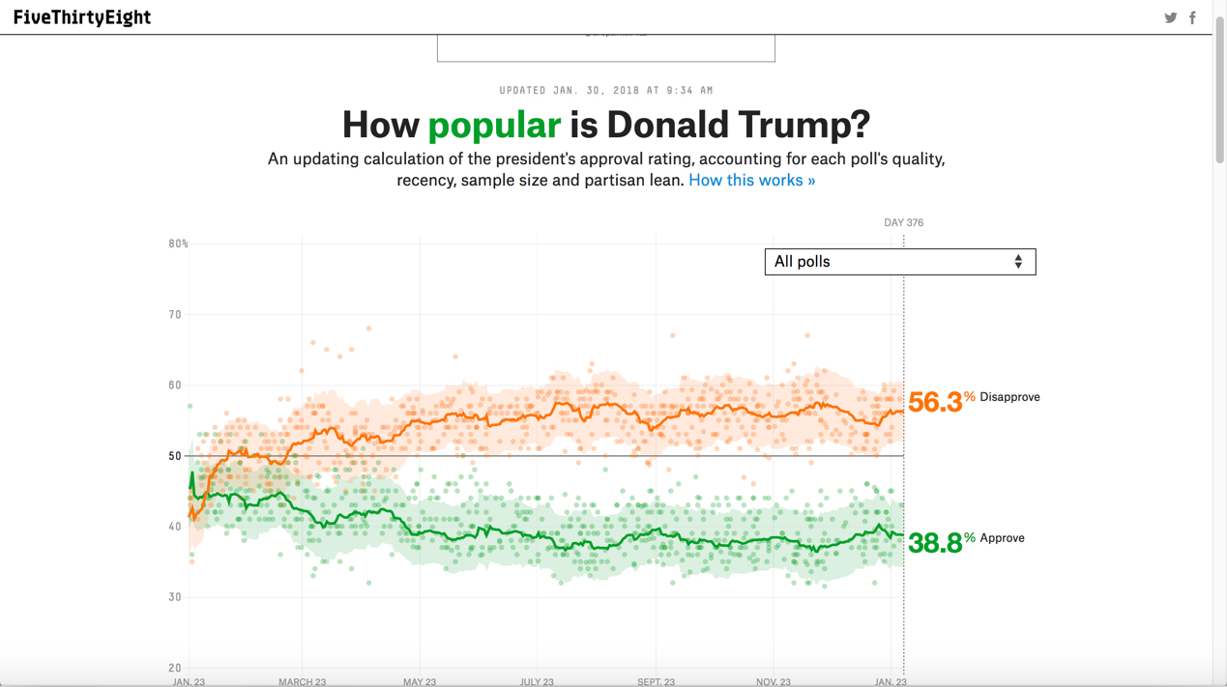
Comparisons

Slide 11
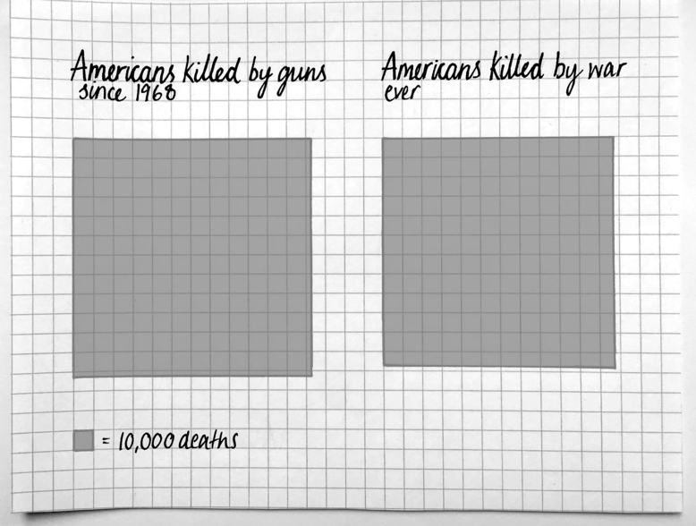
Surprises: Turn something on its head

Slide 12
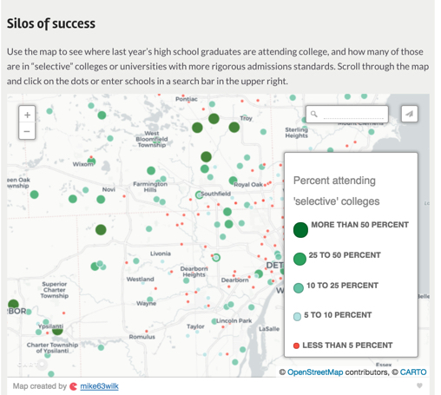
Relationships
Bridge Magazine found that the path to elite colleges flowed through wealthier high schools. To do this, they correlated college attendance rates to “rigorous” or selective schools with areas those students came from.
The Report

Slide 13
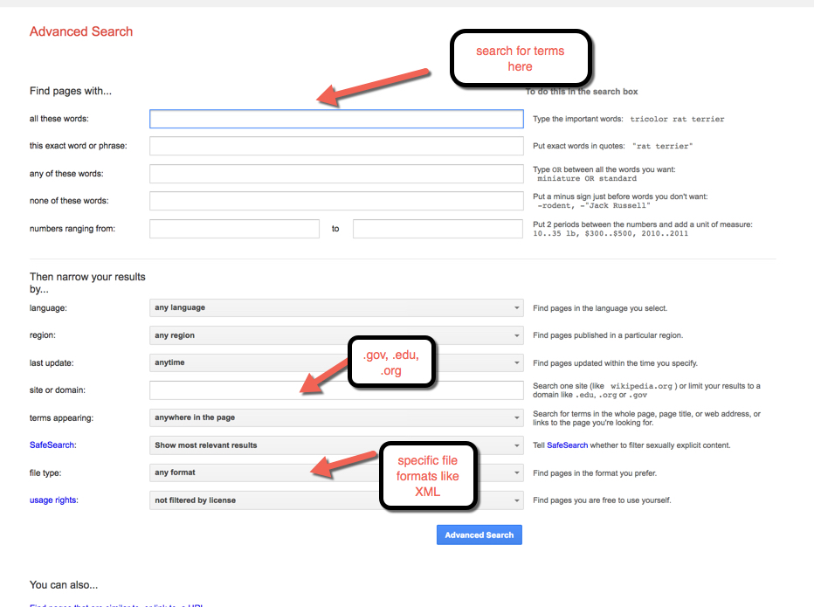
Finding the data: Where and how?
Start with Google.com/advanced_search

Slide 14
Once you have the data, answer:
Where is it coming from?
How was it collected?
What does it all mean? (every field of it)
Ask for a data dictionary or code sheet – these can be extremely relevant in helping you decipher the data

Slide 15
Downloaded data
Make a copy
Make sure to clean it up – check ranges, make sure they are realistic
Download and use Open Refine to clean and standardize (openrefine.org)

Slide 16
Interview your data
Who are the top 5?
What’s the total?
What’s the average?
Think about comparisons – for population numbers, put it in context by comparing to total population
Example: Number of police officers in Detroit vs. Dearborn – raw numbers don’t mean as much as if you look at “per capita” or “per 100 violent crimes.” Normalize the numbers

Slide 17
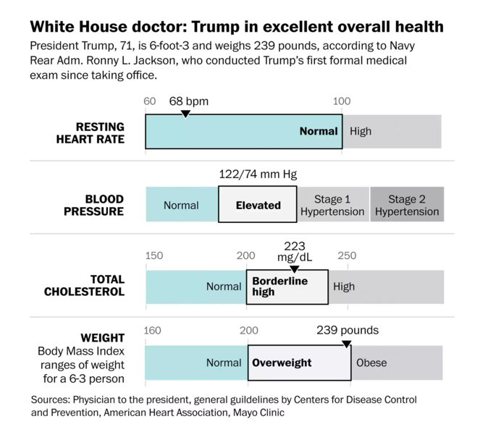
Look for relevance and context; visualize it

Slide 18
If you ask for data, be sure to ask this:
Digital format
Disaggregated, granular (you want the nitty gritty)
XLS or XLSX (Excel), CSV (spreadsheets, comma-separated)
KML or SHP – geographical formats (KML for Google, SHP for most everything else)
HTML or PDF: Can sometimes put it in Excel but it’s not always reliable. But if it’s all you can get …
DBF – need to use database software; a bit more difficult but doable

Slide 19
Must-have tools
Excel
Google Fusion Tables (here’s a tutorial that will teach you)

