Slide 1
Verification tools

Slide 2
Main rule to live by
“If your mother says she loves you, check it out.”

Slide 3
What needs to be verified?
Information given or sent to you
  Emailed, social media, etc.
Sources: People, organizations, websites
Photos, video
Social media posts

Slide 4
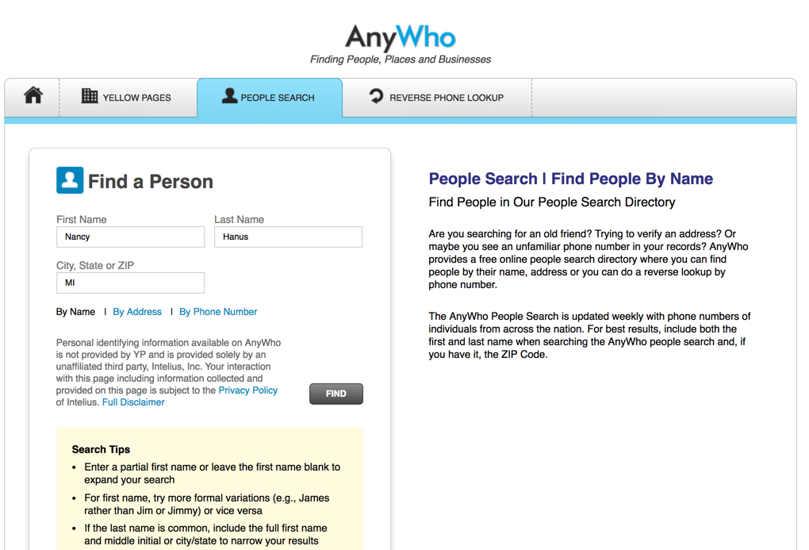
Verifying a source: Who is this person?
Anywho.com: White pages lookup

Slide 5
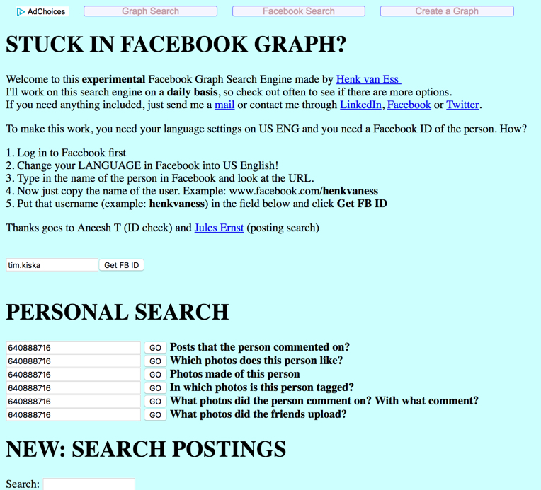
Facebook Graph Search

Slide 6
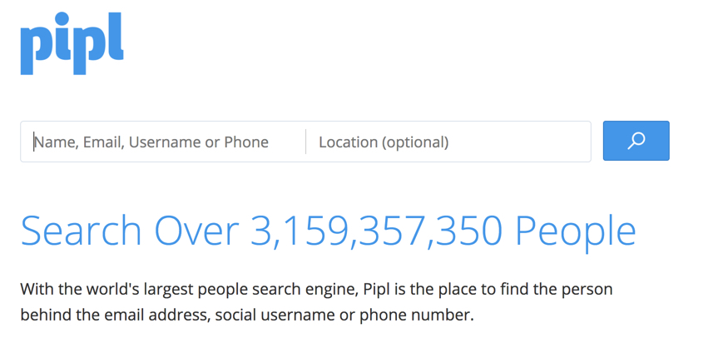
Other people searching tools
Spokeo: https://www.spokeo.com/
Pipl: https://pipl.com/

Slide 7
Information you receive
Provenance: Is this the original piece of content?
Source: Who uploaded the content?
Date: When was the content created?
Location: Where was the content created?

Slide 8
Verifying images
Establish the author/originator
Corroborate the location, date and time of image
Is it what it’s labeled or captioned to be?
Obtain permission to use the image.

Slide 9
Establish owner
Track down the original source
Use Google Reverse Image Search or TinEye

Slide 10

Example from our class blog
Right click on image to get image URL

Slide 11
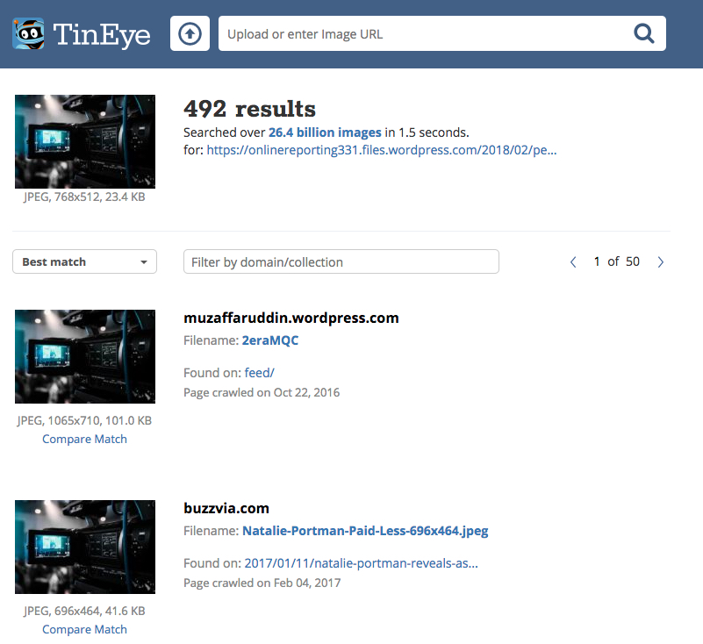

Slide 12
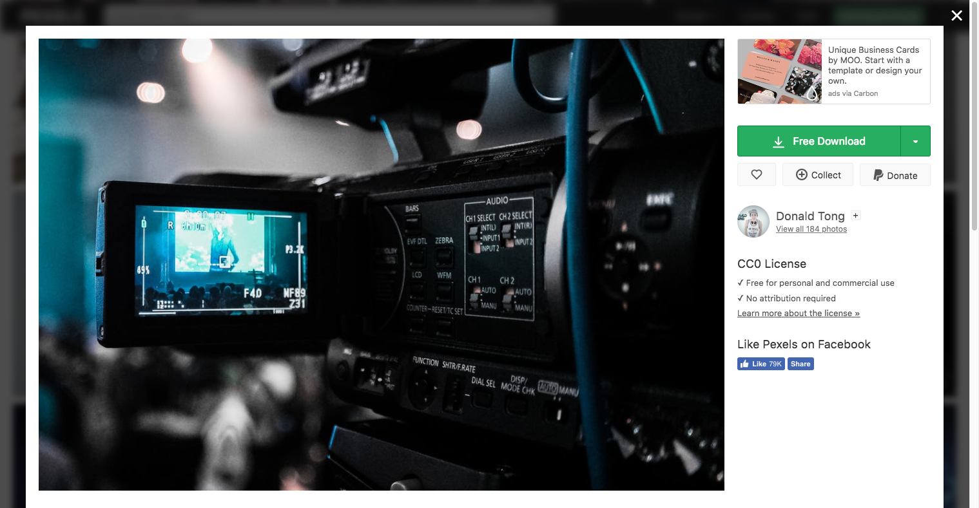

Slide 13
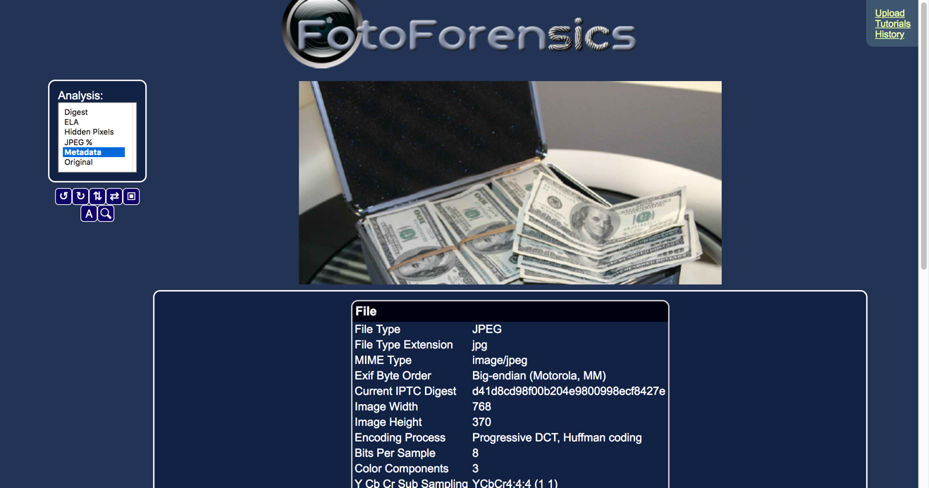
Verify data, location, time of image
Look at the “file info” in Photoshop or use free tools from web:
Fotoforensics.com or Findexif.com to generate an EXIF report

Slide 14
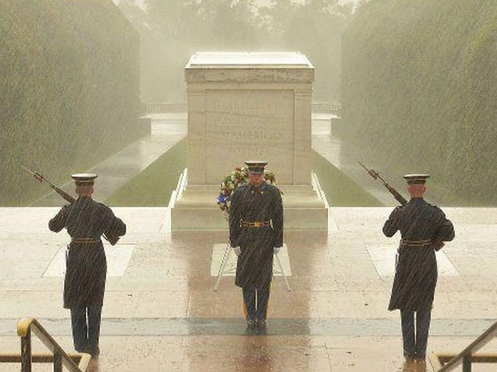
Confirm labeling or caption is accurate
This image widely circulated during Hurricane Sandy: Purportedly of three soldiers guarding the Tomb on the Unknown Soldier.
In reality, the photo was taken a month before – not during the storm

Slide 15
Verify locations
Use Google Maps, Bing Maps or Wikimapia to help you verify locations.

Slide 16
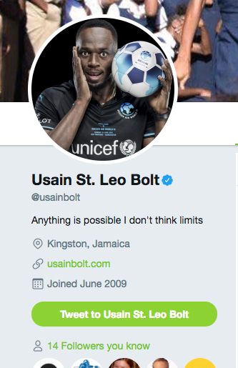
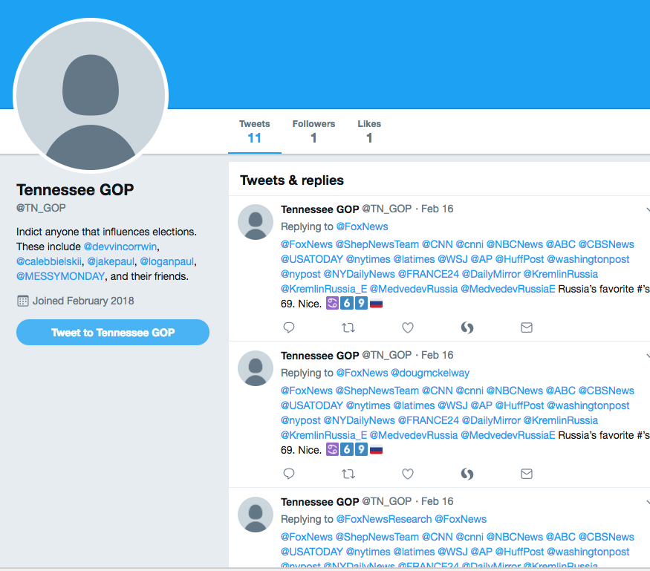
Social media verification
Look for twitter or Facebook verification symbols

Slide 17
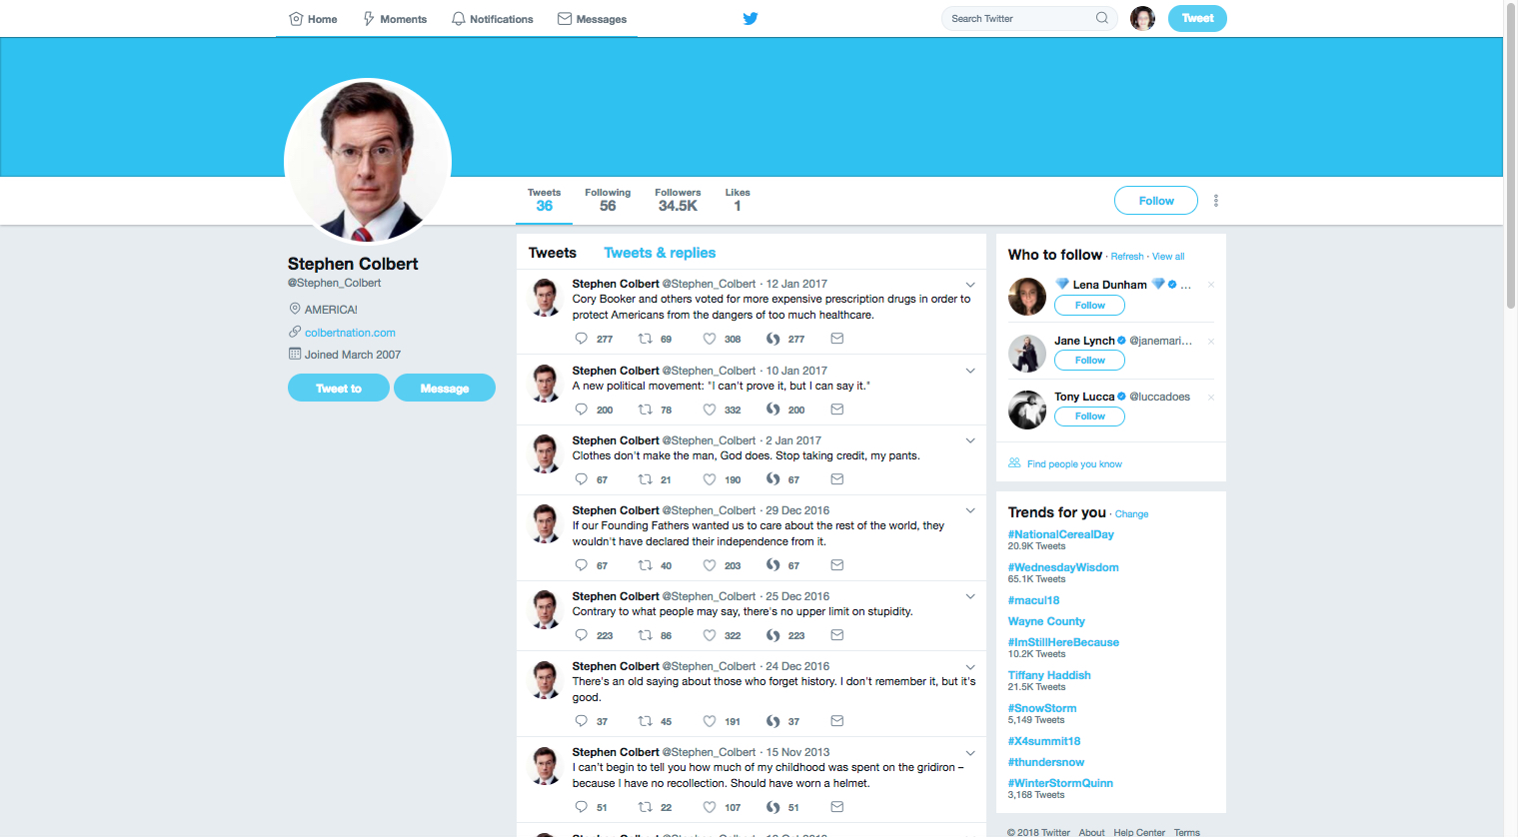
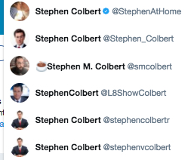

Slide 18
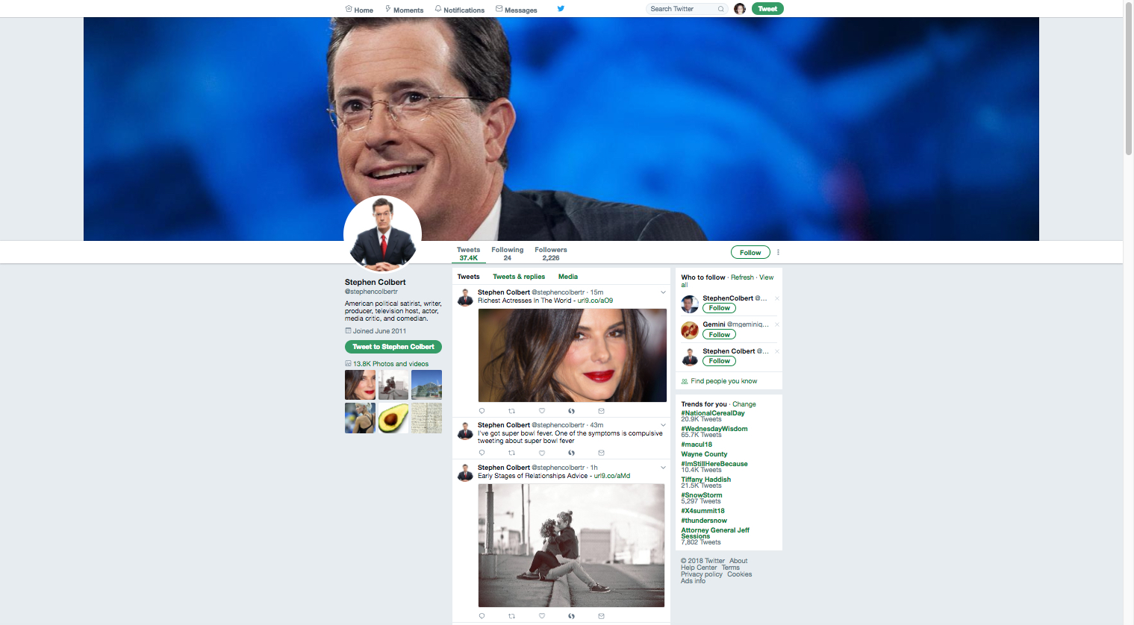

Slide 19
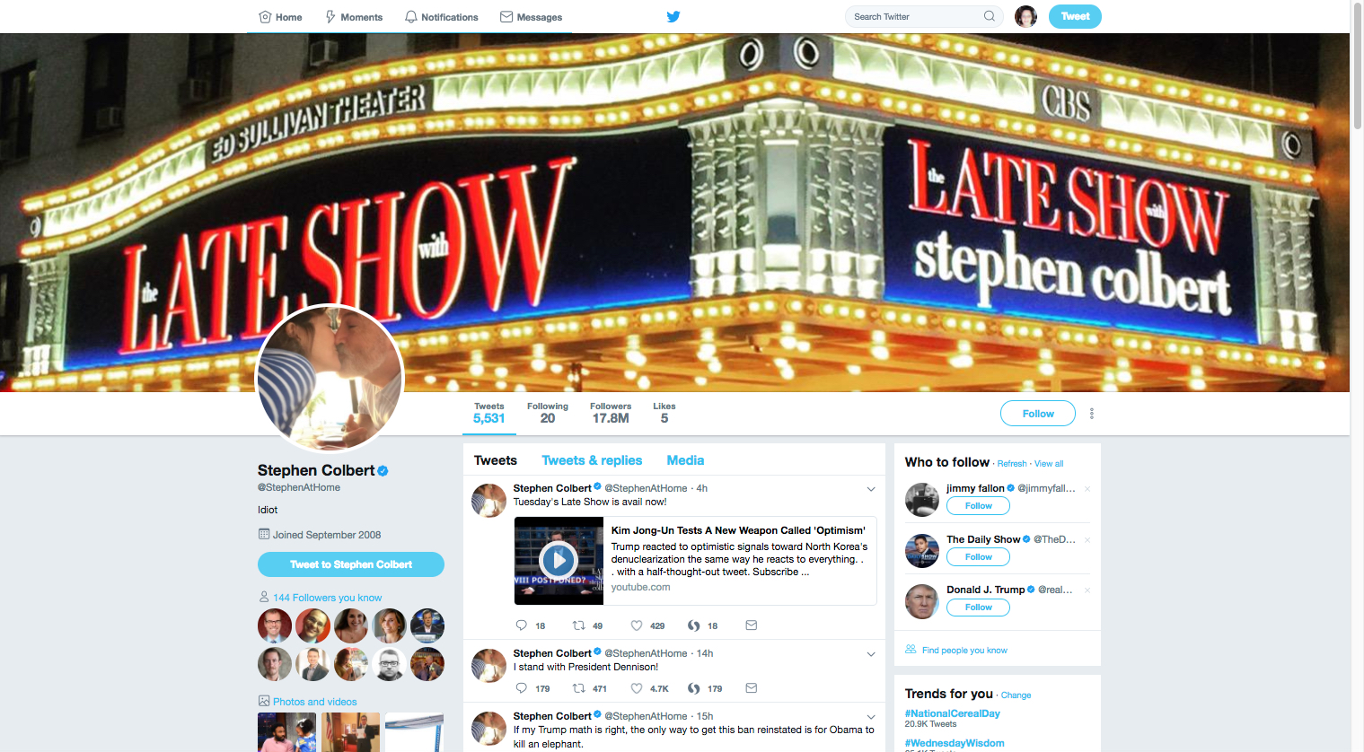

Slide 20
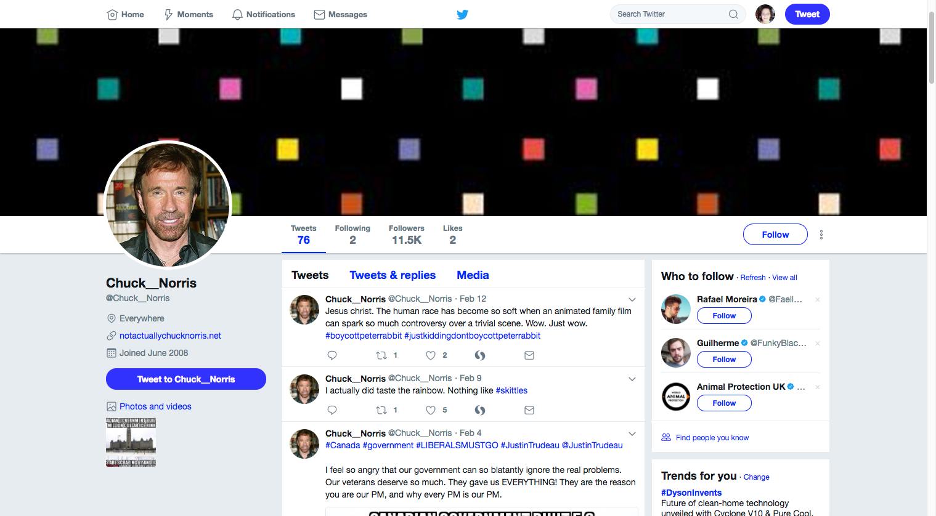
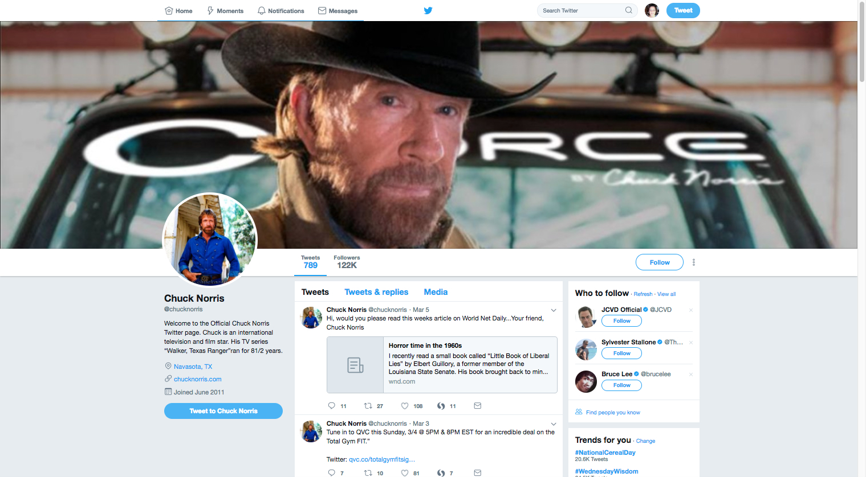
Which one is real?

Slide 21
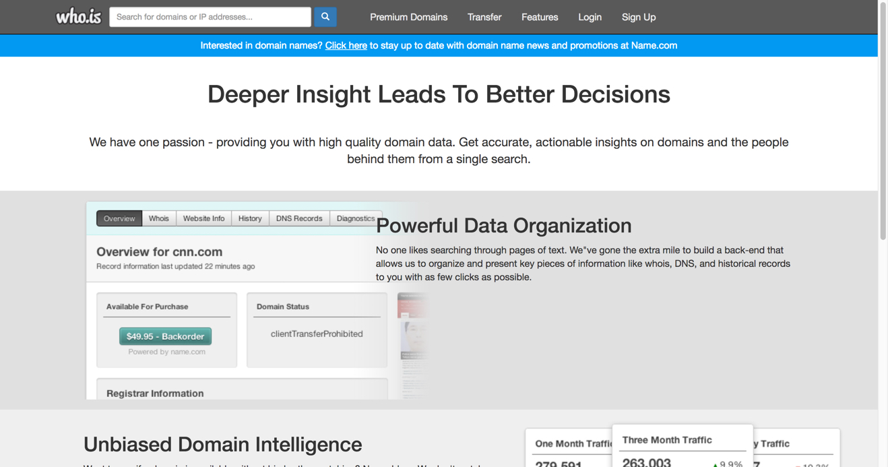
Use Whois.com to track down domain info
Registered users of a domain name and details the date of registration, location and contact details of the registrant or assignee

